Slide 1
Attacks, Motivation and Vulnerability Disclosure
Sharada Valiveti

Slide 2
Phishing Attacks
First known instance of phishing recorded on January 2, 1996
Contained within the Windows application known as AOHell, a multifaceted program frequently used for stealing AOL passwords.
Phishing emails often purport to be from the tech support branch of companies such as Microsoft and Apple.

Slide 3
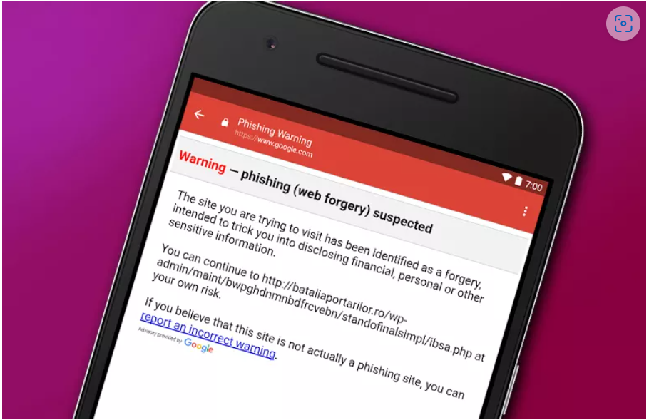

Slide 4
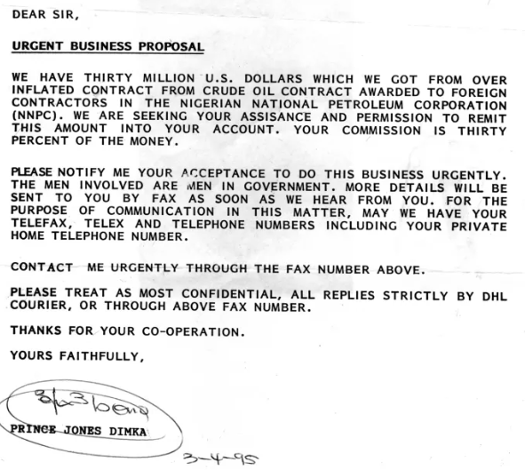

Slide 5
Nigerian Fraud
The email is received unexpectedly,
You don’t know the person who sent it,
It contains a long and sad story about political trouble or family problems,
It contains a long and sad story about why the sender can’t access money,
The email specifically asks you to help by sending money via money transfer services,
The email offers a temptingly large payment in return for your small offering.

Slide 6
Greeting Card Scams
More than likely see them from a hacked account on Facebook
Greetings card scams universally distributed over email
Pretending to be a friend or relative, yet in reality they come from a scammer
Need best antivirus to use any links on these cards

Slide 7
Lottery Scams
Variation of the advanced fee-scam
An email tells you that you’ve won the lottery
You have to first have to pay a small fee in order to collect your earnings, seems completely unbelievable, even by email scam standards
People have fallen for it, leaving them needing to win a real lottery to make up their losses

Slide 8
Guaranteed Loan / Credit Card
Scam shamelessly preys on poor people
Email or on-site advertisement stating pre-approved for credit card or loan that one hasn’t applied for

Slide 9
Fake antivirus software
Someone sends a message while you’re online telling you that your computer is infected with a virus, and that you’re in dire need of an antivirus in order to clean up your system
Actual intent is to infect your computer with a virus

Slide 10
Travel Scams
100% of these offers have a catch
Normally, that catch is planted on your computer (in form of a trojan)
OR the identity is stolen if you provide the necessary information
Usually arrive via email, and caution you that they’re limited-time offers you can’t miss out on

Slide 11
Facebook Impersonation
Friend’s account might get hacked
Oftentimes you’ll receive a message purporting to be from a friend saying something like ‘Did you see this video of you?’
When the link is clicked, you may need to provide login details
Enable 2-step authentication

Slide 12
Job Offer Scams
Chances are that you’re not going to receive a job offer for a position that you didn’t apply for
if you receive such an offer, you’ll want take it with a small confusion
These scams will be attempted by phone, or on LinkedIn to make them vaguely believable
The scammer will try to reel you in by asking for funds in order to take your ‘application’ to the next step
Decide to quit

Slide 13
Fake shopping websites
These sites act as actual retailers, offering normally expensive merchandise for a remarkably low cost, they also overtake vulnerable domains to do so
Need is an eye for spotting malicious links, and a general idea of how much products are worth

Slide 14
Ethical Hacking
Justification, Basic Definitions and Vulnerability Disclosure

Slide 15
Motivation
World wide impact ($)
2005 | 14.2 Billion
2004 | 17.5 Billion
2003 | 13.0 Billion
2002 | 11.1 Billion
2001 | 13.2 Billion
2000 | 17.1 Billion
1999 | 13.0 Billion
1998 | 6.1 Billion
1997 | 3.3 Billion
1996 | 1.8 Billion
1995 | 500 Million

Slide 16
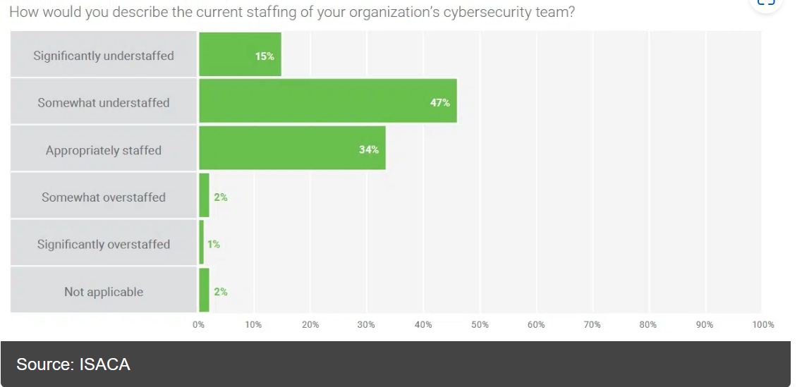
Motivation (2)

Slide 17
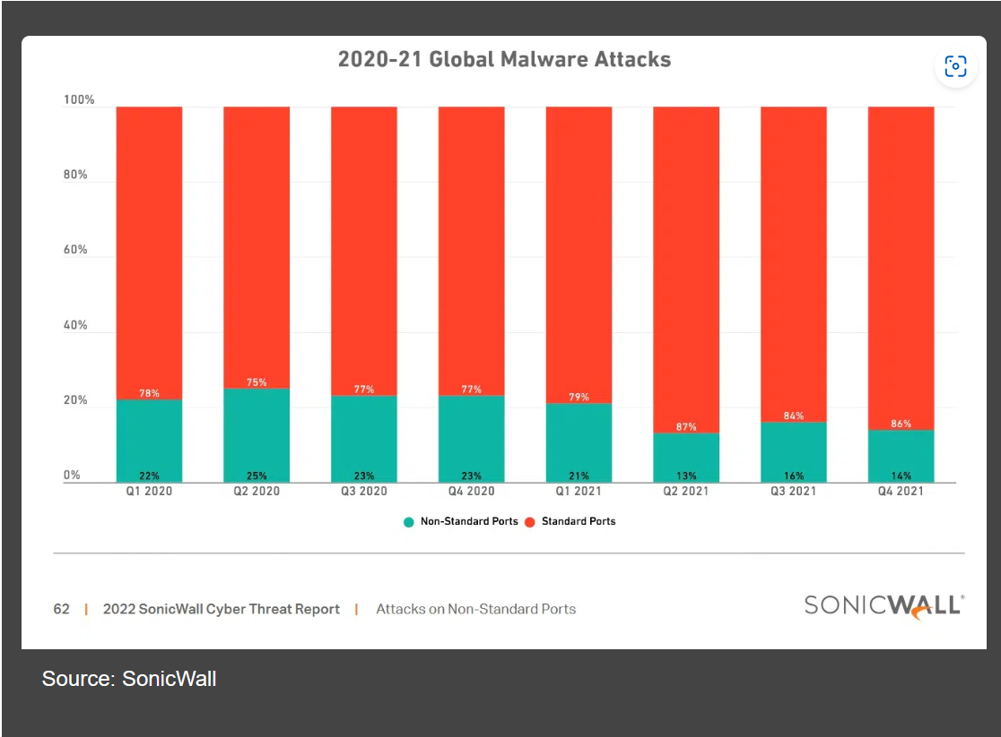
Motivation (3)

Slide 18
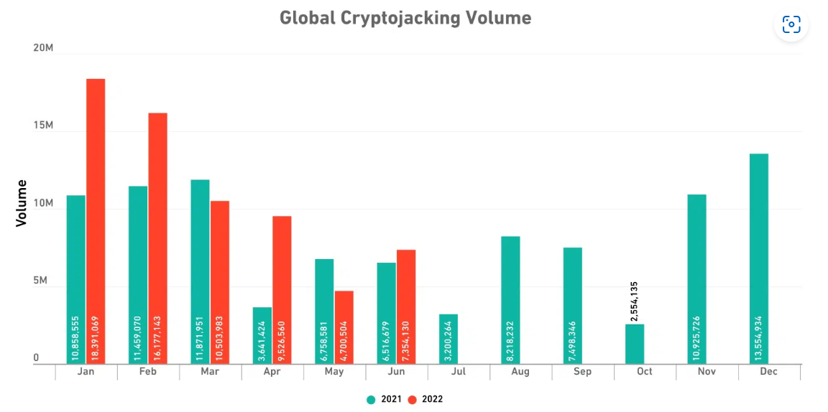
Motivation (4)

Slide 19
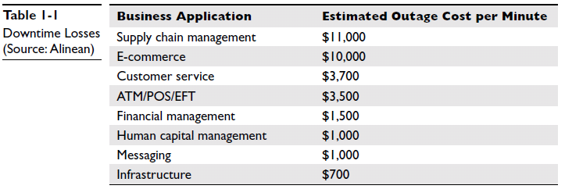
Motivation (5)

Slide 20
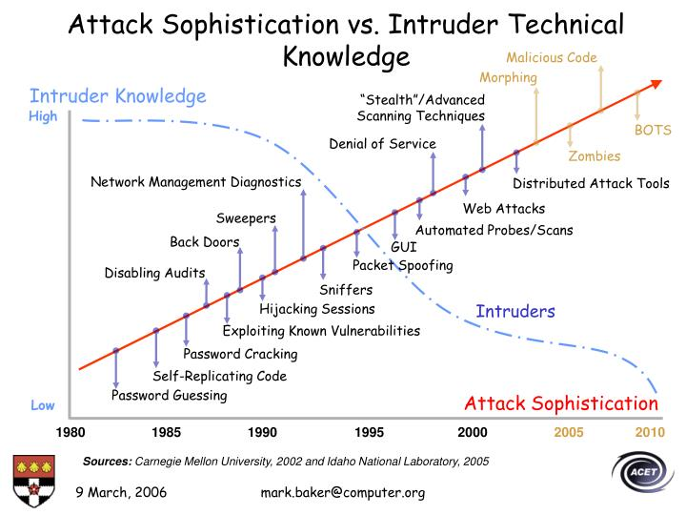
Motivation (6)

Slide 21
Common Steps for Attackers
Reconnaissance
Intelligent work of obtaining information either actively or passively
Examples:
Passively
Sniffing Traffic
Eavesdropping
Actively
Obtaining data from American Registry for Internet Numbers (ARIN)
whois databases
Web sites
Social engineering
Notes:
For the common steps for attacker :
Obtaining info:
Actively or passively
Scanning databases from some info like IP to get more info such as name contact, etc

Slide 22
Common Steps for Attackers (2)
Scanning
Identifying systems that are running and services that are active on them
Examples: Ping sweeps and port scans
Gaining Access
Exploiting identified vulnerabilities to gain unauthorized access
Examples: Exploiting a buffer overflow or brute forcing a password and logging onto a system

Slide 23
Common Steps for Attackers (3)
Maintaining Access
Uploading malicious software to ensure re-entry is possible
Example: Installing a backdoor on a system
Covering Tracks
Carrying out activities to hide one’s malicious activities
Example: Deleting or modifying data in a system and its application logs

Slide 24
Where do Attackers get the Most Traction?
Flaws within software
Security does not like complexity
Estimate in industry: 5 to 10 bugs per 1,000 lines of code => Windows XP has approximately 200,000 bugs
Windows XP is approximately 40 million lines of code
Linux is approximately 2 million lines of code
DLLs, Shared Code Bases, Buffer Overflows etc.

Slide 25
Psychological Reasons
Software vendors do not consider security in the design and specification phases
Programmers have not been properly taught how to code securely
Vendors are not held liable for faulty code
Consumers are not willing to pay more for properly developed and tested code

Slide 26
Ethical Disclosure
SANS - SysAdmin, Audit, Network, and Security
SANS top 20 Security Attack target:
Operating Systems (IE, Libraries, Office, Services, Configuration Weaknesses)
Cross Platform Applications (Web, Database, P2P File Sharing, Instant Messaging, Media Players, DNS Servers, Backup Software, Security, Enterprise and Directory Management Services)
Network Devices (VoIP Servers and Phones, Network and other devices common configuration weaknesses)

Slide 27
SANS Top 20 Attacks (SANS Top 20 Security Vulnerabilities In Software Applications (softwaretestinghelp.com)
Memory Buffer Error
Cross Site Scripting
Unvalidated Input Error
Sensitive Information Exposure
Out of Bounds Read Error
SQL Injection
Previously freed memory
Integer Overflow Error
Cross-site Request Forgery
Directory Traversal
OS Command Injection
Out-of-bounds Write error
Improper Authentication Error
Dereferencing a NULL Pointer
Incorrect Permission Assignment
Unrestricted file upload
Information exposure through XML entries
Code injection
Hard-coded key access
Uncontrolled resource consumption

Slide 28
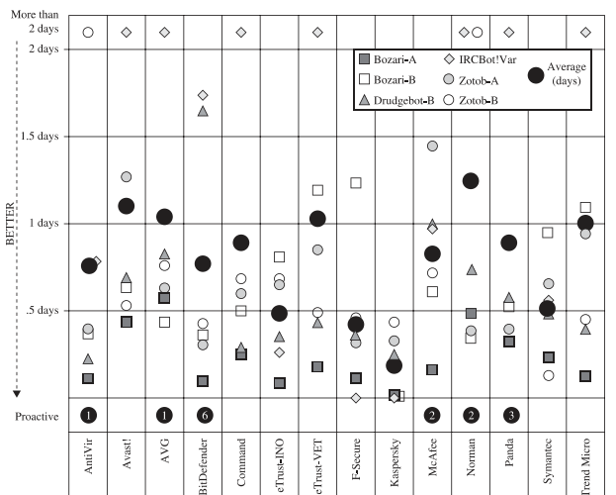
Period of Vulnerability

Slide 29
Disclosure Policy - CERT
Full disclosure to be announced with 45 days of being reported with a few exceptions
CERT/CC to notify software vendors immediately
CERT/CC to forward the name of person reporting vulnerability
CERT/CC to update reporter on current status of vulnerability during 45-day window without revealing confidential information

Slide 30
Full Disclosure Policy - RFPP
Reporter of vulnerability should make an effort to contact and work together with the vendor to fix the problem
As a gesture of goodwill (within 5 days)
Vendor’s responsibility to provide regular status updates every five days
Responsibility of vendor rather than originator
Vendor should credit the originator for identifying the problem
Professional gesture
Maintainer and originator should make disclosure statements in conjunction with each other
If a third party announces vulnerability, originator and maintainer to discuss the situation and come to an aggregate resolution
Many vendors choose not to work under RFP policy

Slide 31
Disclosure Policy - Organization for Internet Safety (OIS)
Vendors and consumers should work together
No private organization to mandate its policy to anyone
Finder Prepares Vulnerability Summary Report (VSR)
Vendor provides single point of contact for vulnerability reports
Provide a secure communication method between itself and the finder
Cooperate with finder, even if it chooses to use insecure methods of communication

Slide 32
A person thinks from Security Perspective only!!!
“
”
Sharada Valiveti

Slide 33
Summary
If a person feels, he is secured enough, he is fooling himself!!!

Slide 34
Thank you
Sharada Valiveti
Sharada.valiveti@nirmauni.ac.in

